Slide 1
Gender Equality through the Arts
Grants Information Session
Notes:
Welcome and thanks for attending the information session this morning this close to the Christmas break
I’d like to start by acknowledging the traditional custodians of the land on which we meet today, the Wurundjeri peoples of the Kulin nation and pay my respects to elders past present and future.
My name is Liz Murphy and I am a senior project officer and have worked in the primary prevention of violence against women and gender equality here at VicHealth for nearly ten years. I would like to introduce my colleagues Emma Cook and Jim Rimmer who are also involved in this work and should you have any further queries after today it will be one of the three of us you will be in contact with.
Aims of this funding round are to develop Creative projects that:
● raise awareness, engage with and progress contemporary ideas about gender equality and celebrate and promote Victorian women and girls as independent leaders, and as equal, capable and valued members of the community
● provide councils with an opportunity to engage arts strategies to address the gendered drivers of violence against women and promote greater wellbeing
● increase councils partnerships with arts and corporate organisations to act on gender equality
● assist us to build the evidence base on what works in the arts to promote gender equality.

Slide 2
Why Arts and Gender Equality makes sense for Health
VicHealth’s Gender Equality, Health and Wellbeing strategy 2017-19.
Safe and Strong A Victorian Gender Equality Strategy
VicHealth’s Art’s Strategy
2017-19
Notes:
VicHealth recognises the importance of gender equality as not only a fundamental human right, but also a key determinant of our health and wellbeing. This is informed by our long investment in the prevention of violence against women. Victorian Gov’s Gender Equality Strategy also highlights the arts and creative industries capacity to influence gender norms, challenge the expectations placed upon girls and women, and address the disadvantage and discrimination they face.
The arts, culture, and creative industries play a central role in promoting health and preventing illness and VicHealth’s current Arts Strategy has a strong focus on developing new partnerships and approaches to build health benefits and bring new ideas and sectors on board to creatively address health problems.
Victorian Councils have become leaders in modelling and advocating for gender equality within communities and, as such, have been identified as a powerful conduit through which communities can engage with the arts to raise awareness, explore the impacts of gender inequality and promote healthier and more equal gender norms. Because local councils have a deep understanding of the issues impacting their communities and significant reach across diverse groups they are ideally situated to use local partnerships to create art that can improve health and wellbeing.

Slide 3
Changing the Story on the Gendered
drivers of violence against women
challenging gender stereotypes and roles
strengthening positive, equal and respectful relationships
promoting women’s independence and decision making
challenging the condoning of violence against women.
Notes:
All of our gender equality work here at VicHealth and across all levels of Govt is informed by the National Framework for the PVAW & children – Change the Story.
The framework highlights the key gendered drivers of this violence and how idealised depictions of women and rigid ideas of masculinity and femininity help to uphold a culture in which violence against women is rife.
It is this evidence base that forms the rationale for this grants program and we will be looking for proposals that can demonstrate a clear articulation of how their initiative will address these key drivers through their arts projects. Link to this Framework is in your guidelines
Some of you in the room I know are familiar with this Framework and the drivers of violence against women and I would encourage those less familiar to partner with organisations or other departments across Council who have a deeper understanding of this work.

Slide 4
What’s on Offer
Grants of up to $85,000 to Councils working with
Arts, Cultural & Creative organisations
Public or Private sector
with expertise, reach and/or funding.
Notes:
Grants of up to $85,000 (excluding GST)are available for projects to be developed and delivered over 12 months. All funds must be expended by May 2020.
Local Government projects will be chosen based on their existing partnerships or potential to collaborate with arts, cultural and creative sectors and public or private sector partners with the capacity to attract additional expertise, reach and/or funding. Projects may be newly created or if current arts initiatives exist that fit the requirements and focus on gender equality and you wish to expand and extend the project and the reach, these initiatives will also be considered.
Proposals may be for a smaller amount. Our assessment panel may decide an initiative is promising but due to limited funds we cannot award it the maximum amount, in which case you would be offered a smaller grant with the option of revising your proposed budget accordingly.
Many of the projects reviewed in the Gender Equality through the Arts report developed partnerships with corporate or philanthropic organisations who were able to considerably extend the reach and lifespan of an art work through publicity, location or additional funds. We know there are many organisations with a growing commitment to gender equality who may be willing to support your projects and we are keen to see proposals that show links with such organisations or a willingness to explore this.

Slide 5
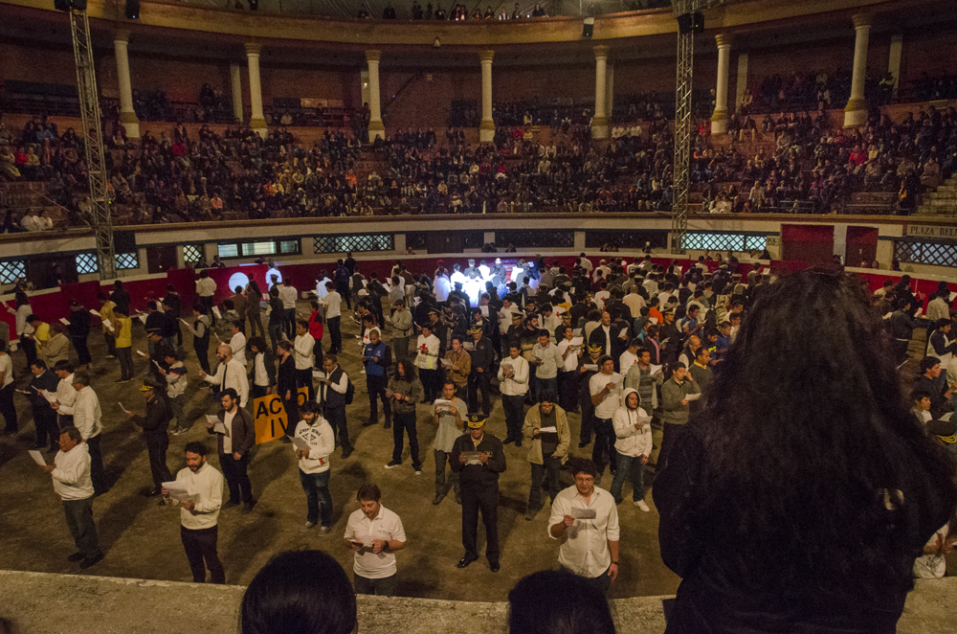
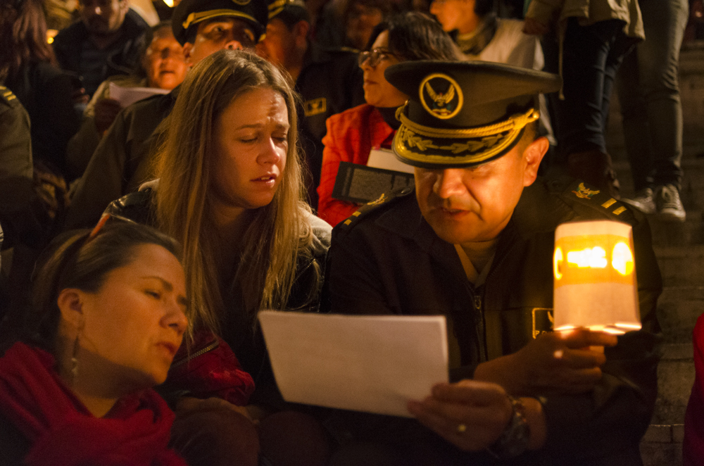
Gender Equality Through the Arts and Creative Industries – A Review of case studies and evidence
Notes:
VicHealth commissioned a research team from The University of Melbourne and Deakin University to review international projects to assist us to understand how art can be used to help promote gender equality in Victoria, This report documents their key findings.
More than 100 gender-related art projects were considered during the research; 30 of these were reviewed in detail. The projects included local community-based activities, major art events and multi-site projects using digital technology
The projects aimed to interrogate, question, disrupt and/or reform gender relations in different ways using different art forms and activities
The research found that art can be a powerful tool to promote gender equality for health and wellbeing and inspire cultural awareness, social connection and change. It can help people build empathy by seeing the world through another’s eyes and provides an understanding of the issues that lead to gender inequality. It found that Art can uniquely connect the heart and the head and motivate people toward social change.
The images above are from an Ecuadorean project in which men created a public performance based on letters written by women affected by intimate partner violence. This is one of 5 case studies that form part of the summary report that illustrate arts initiatives that could be developed in the Local Government setting.

Slide 6
Alison Lapper Pregnant’, Marc Quinn, 2005 Case Study - The Fourth Plinth
Notes:
The Fourth Plinth was a vacant plinth in Trafalgar Square, London. Because no one could agree on a fourth permanent statue, it was decided that it should feature temporary art installations.
The City of London now manages the initiative, via the Fourth Plinth Mayoral Commissioning Group, which is comprised of notable arts representatives.
The statue contrasts with other statues in Trafalgar Square, which feature historical male military heroes.
Alison Lapper is an artist and lecturer who has faced profound challenges and prejudice that she has fought to overcome. Allison is naked and heavily pregnant in the sculpture, making its messages about gender even more powerful. The sculpture challenges social norms and expectations of gender, femininity, motherhood and disability. It also challenges our ideals of female beauty and physical perfection, by proudly displaying a different kind of beauty and physical form.
The sculpture’s presence was also a huge boost for gender and disabled rights in the UK.
There were a broad range of partners from private business to Arts and Media that supported the project’s powerful visibility, allowing it to stretch and extend the impact of the work. It brought attention to a woman who society and history wanted to forget. A huge inflatable version of the sculpture was later a centrepiece of the London 2012 Paralympic Games opening ceremony. Alison and Marc were able to create a legacy of understanding, acceptance and long-term social change.

Slide 7
Promising Practice Principles
Engender understanding and empathy regarding inequities/discrimination experienced by women
Disrupt gender stereotyping
Uncover untold women’s stories of our past, present and futures
Shine a light on unhealthy/unsafe cultures or environments
Create visibility of women in public spaces
Scalability
Extend value through opportunity, publicity, prominence and partnership
Evaluate and contribute to an emerging evidence base.
Notes:
Successful proposals will demonstrate which of the promising practice principles from the evidence review your project will address to maximise impact, reach and opportunities for social change.
Specify your target audience (e.g. young women in technology, men in sports clubs, isolated rural women, teenagers, people with a disability, general community, school communities).
Demonstrate Council’s capacity to engage communities in both the creation and public presentation of the arts/creative initiative and for extending the reach and impact of the initiative as outlined in the Gender Equality and Arts Evidence Review Summary.
Indicate how the project will raise awareness amongst local communities of the health impacts of gender inequalities and problematic gendered social norms and increased support for greater gender equality.
Demonstrate how the project will increase social connection between individuals and amongst communities that have engaged in the arts gender equality initiatives in local government settings.
Proposals will be required to address specific barriers faced by groups to ensure those who are most excluded in their local communities are given opportunities to participate and therefore increase their levels of social connection. These groups may include those with disability, or those from CALD communities, young people, LGBTI, Indigenous or remote communities.

Slide 8
Stretching the impact of your project
Scaling up, stretching or extending projects
Partnerships
Investment
Target audiences
Legacy
Durability
Accessibility
Notes:
Demonstrate how the arts initiative will be sustainable after the Arts Grant funding has ended.
Scaling up, the ability to extend or stretch the work. For example, touring work or using for political advocacy to extend the gender equality messages more widely .
Partnerships organisations with similar gender equality goals, provides access to more resources for wider audience & greater impact. Can involve money, access to networks, technology, distribution outlets, materials, information, exhibition space.
Investment financial, time, publicity or prominence –to grow or extend their reach and impact for the long-term. This can increase a project’s durability, accessibility and legacy.
Target audiences The audiences can vary focussed on ethnicities, gender identities, class, literacy levels, abilities, age and sexualities. Identify your audience and tailor art to best engage for impact. May involve audience participation through virtual reality, games or workshops, with audience as ‘co-creator’.
Legacy art can be enjoyed or valued in the moment, but can also have a lasting impact on individuals and communities in the future. It can lead to cultural change. legacies include encouraging girls to enter male-dominated fields, and changing ideas around gender, masculinity and violence against women.
Durability refers to the artwork’s ‘lifespan’ – how long it lasts or has influence to reach and affect more people. Examples include recorded performances and screen-based art (e.g. online games).

Slide 9
https://www.tmiproject.org/lockerroomtalk/
Notes:
I want to leave you with a video to give you a taster of an initiative using the sports setting for art to occur.
The goal for Locker Room Talk a memoir writing and storytelling project, and their ongoing collaboration with the violence prevention organization A Call To Men is to inspire more men and boys to step outside of the rigid gender roles proscribed and speak up to challenge the culture of acceptance of violence against women.
Driven by The #MeToo movement which has empowered women to unearth their stories, both organizations believe that if there are opportunities for boys and men to share and explore such themes, it will allow for a foundational shift in the way they relate to each other and to women.
This projects provides a great example of how art can engage a community in powerful ways to enlighten and broaden understanding and tackle specific identified problems. It has also extended the reach and impact of its initial storytelling workshops through the development of this documentary and now has a durable global online presence.

Slide 10
QUESTIONS?

