Slide 1
Notes:
9:30
Welcome to the Deakin Community Cats Centre
As students walk in (after they have put bags away) hand out iPads and have complete survey
Introduce ourselves

Slide 2
Acknowledgement of Country
The Geelong Cats and Barwon Child, Youth & Family would like to acknowledge the Wathaurong people of the Kulin Nation as the Traditional Custodians of the land on which we meet today and pay our respect to their Elders past and present.
Notes:
Acknowledgement of Country

Slide 3
Housekeeping
Toilets
Mobile Phones off
We will all be respectful of each other.
Talking about alcohol generally and not asking anyone to talk about alcohol in relation to themselves or their family.
If you have any concerns or the material brings up any issues, please talk to your teacher and the presenters can be of further assistance.
Notes:
Housekeeping
Toilets
Mobile Phones off
Confidential, safe space- you will not be asked about your own alcohol use

Slide 4
Just Think
incorporates the messaging of the SMART GENERATION alcohol program developed by the Deakin University School of Psychology and is informed by the Australian National Health and Medical Research Council (NHMRC)

Slide 5
Purpose of the Just Think Program
Recommend that you do not drink until you are at least 18 years old.
Inform you about alcohol and its effects.
Inform you of the risks associated with alcohol use.
Inform you that it is illegal for an adult to supply you with alcohol without your parent’s consent ($7,000+ fine)

Slide 6
Icebreaker
A statement will be read out.
If you think it’s true –
stand to the right of the room →
If you think it’s false –
stand to the left ←
Notes:
Icebreaker Activity - True False Run
The group stands in the middle of a room (or if outside, between two markers e.g. cones). One wall/marker is nominated 'true' and the other 'false'. The leader reads a statement, e.g. 'bats aren't actually blind'. On 'Run!' the kids must run for whichever side they think is correct - true or false - and whoever reaches the correct wall/marker first wins. STAYING IN THE CENTRE IS NOT AN OPTION. Disqualify stragglers if necessary. Tally the winners on a board and award the overall champion a prize. Alternatively, the kids who choose the wrong answer are eliminated, and only the correct side continues to the next round.

Slide 7
Alcohol and Violence
Interview video
CCTV:
https://www.youtube.com/watch?v=AW2GbGibNj0
Notes:
Discuss how the Just Think program started
- One punch attack in Melb on 20-year-old cats fan prompted players to start the program

Slide 8
Is drinking alcohol normal?
According to the World Health Organisation, what percentage of the world’s population over 14 has not had a drink in the past year?
20 - 25 %
50 - 58%
12.5 - 15%
32- 37%
Notes:
Discuss reasons why this is the case

Slide 9
What is Normalisation?
Social processes through which ideas and actions come to be seen as ‘normal' and become taken-for-granted or 'natural' in everyday life.

Slide 10
What contributes to the normalisation of alcohol?
TV Shows
Movies
Music
Social Media/internet
Notes:
What other types: Billboards, Movie product placements
Ask for examples of this – eg. The Simpsons, Big Bang Theory

Slide 11
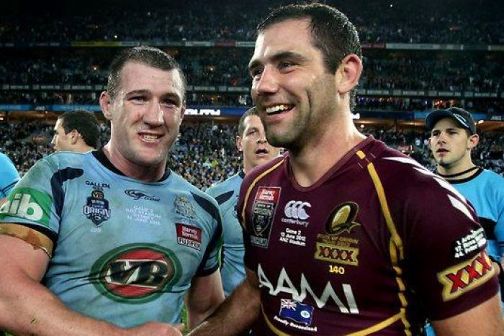
SPONSORSHIP
Notes:
What team are they actually playing for vs who it looks like they play for

Slide 12
ALCOHOL ADVERTISING
Notes:
Target audience: Lord of the Rings fans- not a true fan unless you drink “Tuborg” beer

Slide 13
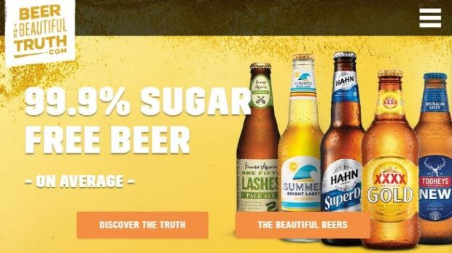
ALCOHOL ADVERTISING
Notes:
Implies that beer is healthy

Slide 14
ALCOHOL ADVERTISING
Notes:
Targeting minority groups, makes them feel inclusive

Slide 15
Dangers of Drinking Adverts
Anti-alcohol adverts will be handed out. They have had their messages blanked out. These messages will also be handed out. You must find the person with the matching message/advert.

Slide 16
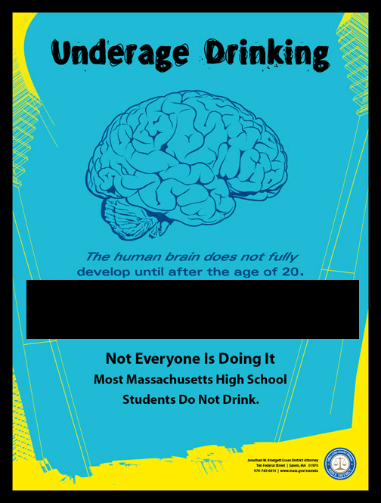
What is the Message?
Drinking can cause permanent Brain Damage

Slide 17
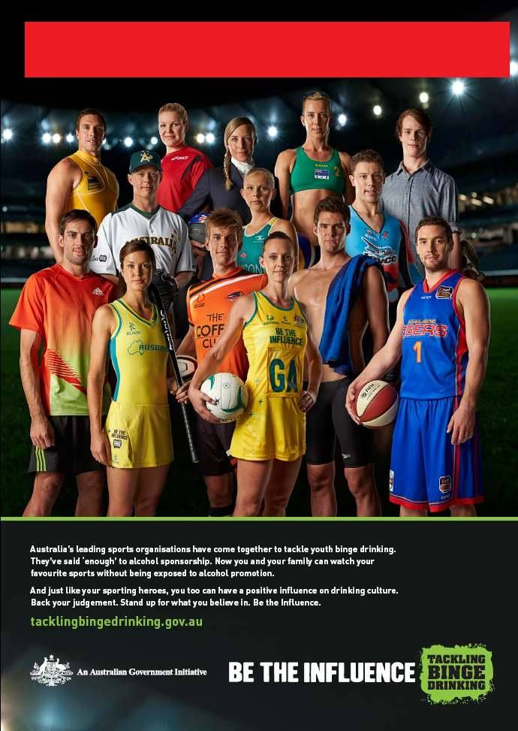
What is the Message?
Strong enough to say ‘enough’

Slide 18
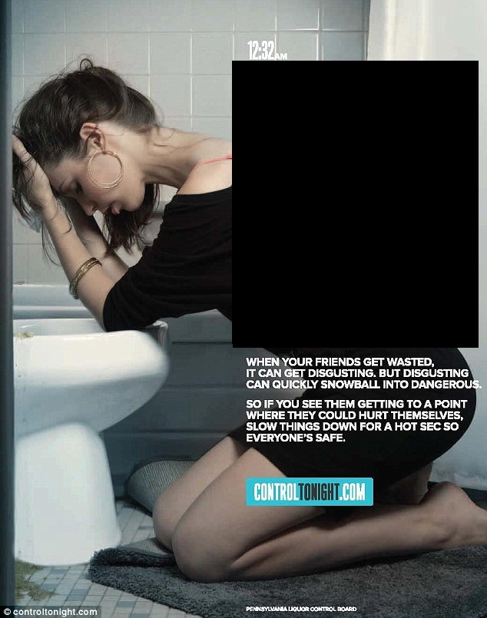
What is the Message?
She’s got a date with a porcelain prince

Slide 19
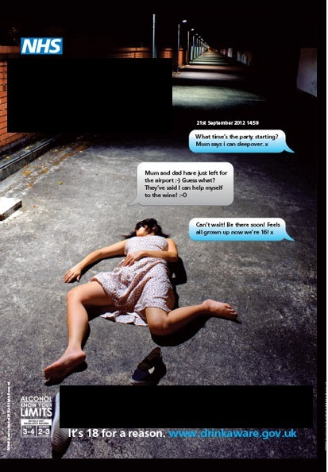
What is the Message?
UNDER the influence?
UNDER age?
UNDER control?
Think About It

Slide 21
Risk and Consequence Activity
You will be given a scenario. At the back of the room are the risks and consequences of each scenario.
Find the risk and consequences that match your scenario.
Risk = short term impact
Consequence = long term impact
Notes:
Outline what the difference is between risks and consequences.

Slide 22
What we have learnt so far
Most people do not drink alcohol.
None of the many negatives of alcohol are mentioned in ads, sponsorship or any alcohol sponsored social media content.
You are being encouraged to think of alcohol as an everyday activity when in fact it is extremely unhealthy for you.

Slide 23
What we have learnt so far
Anti alcohol ads try to show you the negative sides to drinking
There are both immediate and longer term risks and consequences to drinking, which we will further explore.

Slide 24
Break time

Slide 25
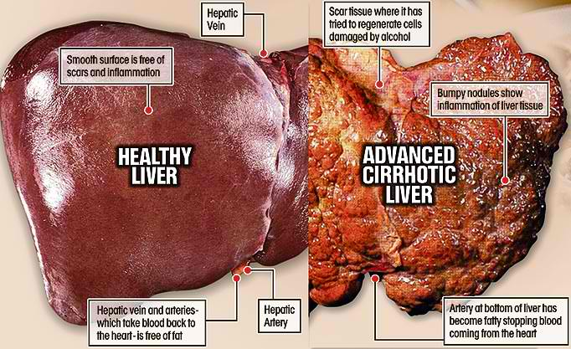
Alcohol and Health
Long term effects
Increased risk of cancer
Bowel, breast, throat, mouth, liver
After being consumed, alcohol is converted into a carcinogen – a substance that causes cancer, much like smoking cigarettes
Liver disease
Cardiovascular (heart) disease
Stroke
Brain damage
Low levels of regular
consumption can cause
brain damage also
Including learning difficulties, cognitive (thinking) abilities, memory loss, hallucinations.

Slide 26
Alcohol and Endorphins
Alcohol and exercise stimulate the brain to release similar chemicals which provide feelings of wellbeing.
Exercise is exceptionally good for you, while…..
Alcohol is toxic and damages the brain and the body.
Notes:
Link as an activity to do that does not involve alcohol

Slide 27
Alcohol and Sports Performance
Common sports goals
Get Stronger
Healthy weight
Perform well
Recover well
Build muscle
ALCOHOL WILL IMPACT ALL
OF THESE GOALS

Slide 28
Physical Activity Session

Slide 29
Alcohol and Mental Health
May lead to alcohol dependence
Mental health problems
Difficulty coping with work or school commitments
Depression
Self-harm
Suicide
Anxiety
Anger & aggression
Less able to control emotions and impulses

Slide 30
If you are concerned about yourself or someone else who could you speak to?
Your teachers
School Wellbeing coordinator
School Nurse
Your Doctor
A friend who could support you to talk to someone
Parent or carer or relative
Headspace / Lifeline
Notes:
Thanks for coming/goodbye
Help and support lines
Survey on iPad
Finish by 2:30-ish

Slide 31
Teen alcohol poisoning death:
https://www.youtube.com/watch?v=bUKLHa4f7h4

Slide 32
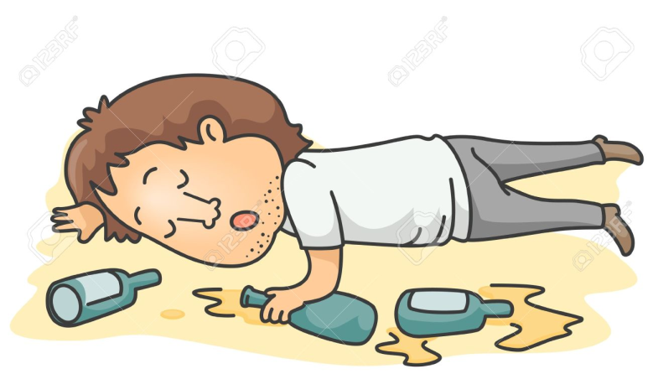
If someone collapses at a party ….
Stay with them
Put them in the recovery position
Call an ambulance 000
know the address
and don’t hang up
Get an adult
Notes:
Run through how to put someone in the recovery position

Slide 33
Alcohol and Community
Reduced hospital beds
Over 18,000 times people were hospitalised in 2011 in Western Australia for alcohol related incidents
Police resources
2 out of 3 incidents that police
attend are drug/alcohol related
Drink driving
Not only risks the driver’s life
but also others on the road
$36 Billion is the total economic impact of alcohol misuse
70% of adult Australians will be affected negatively by someone else’s drinking in a year.
Domestic violence
70,000 people are affected each year
Notes:
From the ABS and Department of Justice

Slide 34
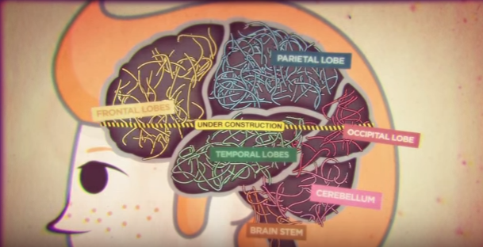
Alcohol and the Brain
https://www.youtube.com/watch?v=g2gVzVIBc_g

Slide 35
Alcohol and Adolescent Brain Health
Effects
Dehydration
Lowered motor function and slower reflexes
Blackouts – memories stopped being formed
Impairs myelination brain development
Reduces inhibitions
Less able to control emotions and impulses
Notes:
Ask group about what dehydration/myelination/inhibitions are

Slide 37
Alcohol’s Effect on the Brain

Slide 38
News making
Alcohol and Health
Alcohol and Relationships
Alcohol and Violence
Alcohol and Risk
Alcohol and the Brain

Slide 39
How to say ‘No’
A situation may occur where someone offers you a drink.
How would you say no?
How could you avoid drinking alcohol?
Write your way of avoiding drinking alcohol on a piece of paper

Slide 40
Have a talk with your parents about
The risk of injury
The risk to physical health
The risk to the brain
Benefits of not drinking
Consequences of someone drinking
Having a plan if things go wrong when out
.

Slide 41
WHAT DID WE LEARN TODAY?
The best medical advice tells us that not drinking until you are at least 18 years in order to avoid:

Slide 42
WHAT DID WE LEARN TODAY?
Permanent brain damage
Immediate physical Injury to yourself and others
Developing a dependence on alcohol
Affecting good judgement
Impacting on our school results
Affecting relationships

Slide 43
WHAT DID WE LEARN TODAY?
If we have friends drinking, look after them and
Never leave an unconscious person alone; Stay with them and seek medical attention.

Slide 44
Trust and Team games
Sports Education and Development Academy
Team Challenge

